Slide 1
UNIT-II (Common To All) ARTIFICIAL INTELLIGENCE
Dr T V RAJINI KANTH
PROFESSOR & DEAN R&D
SNIST

Slide 2
UNIT-II
Games
Optimal Decisions in Games
Alpha–Beta Pruning
Defining Constraint Satisfaction Problems
Constraint Propagation
Backtracking Search for CSPs
Knowledge-Based Agents
Logic, Propositional Logic
Propositional Theorem Proving:
Inference and proofs
Proof by resolution
Horn clauses and definite clauses

Slide 3
GAMES
Games introduced multi-agent environments, in which each agent needs to consider the actions of other agents and how they affect its own welfare.
The unpredictability of these other agents can introduce contingencies into the agent’s problem-solving process.
In competitive environments, in which the agents’ goals are in conflict, giving rise to adversarial search problems—often known as games.
Mathematical game theory, a branch of economics, views any multi-agent environment as a game, provided that the impact of each agent on the others is “significant,” regardless of whether the agents are co-operative or competitive.
In AI, the most common games are of a rather specialized kind—what game theorists call deterministic, turn-taking, two-player, zero-sum games of perfect information (such as chess).
Deterministic means fully observable environments in which two agents act alternately and in which the utility values at the end of the game are always equal and opposite.
Ex: if one player wins a game of chess, the other player necessarily loses. It is this opposition between the agents’ utility functions that makes the situation adversarial.
Games, unlike most of the toy problems are interesting because they are too hard to solve. For example, chess has an average branching factor of about 35, and games often go to 50 moves by each player, so the search tree has about 35¹⁰⁰ or 10¹⁵⁴ nodes.

Slide 4
Games, like the real world, therefore require the ability to make some decision even when calculating the optimal decision is infeasible. Games also penalize inefficiency severely.
Pruning allows us to ignore portions of the search tree that make no difference to the final choice, and heuristic evaluation functions allow us to approximate the true utility of a state without doing a complete search.
Min-Max Algorithm:
We first consider games with two players, whom we call MAX and MIN for reasons that will soon become obvious.
MAX moves first, and then they take turns moving until the game is over.
At the end of the game, points are awarded to the winning player and penalties are given to the loser.
Figure 5.1 shows part of the game tree for tic-tac-toe (noughts and crosses).
From the initial state, MAX has nine possible moves.
Play alternates between MAX’s placing an X and MIN’s placing an O until leaf nodes are reached corresponding to terminal states such that one player has three in a row or all the squares are filled.
The number on each leaf node indicates the utility value of the terminal state from the point of view of MAX; high values are assumed to be good for MAX and bad for MIN (which is how the players get their names).
For tic-tac-toe the game tree is relatively small—fewer than 9! = 362, 880 terminal nodes.
But for chess there are over 10⁴⁰ nodes, so the game tree is best thought of as a theoretical construct that we cannot realize in the physical world.
But regardless of the size of the game tree, it is MAX’s job to search for a good move.
We use the term search tree for a tree that is superimposed on the full game tree, and examines enough nodes to allow a player to determine what move to make

Slide 5
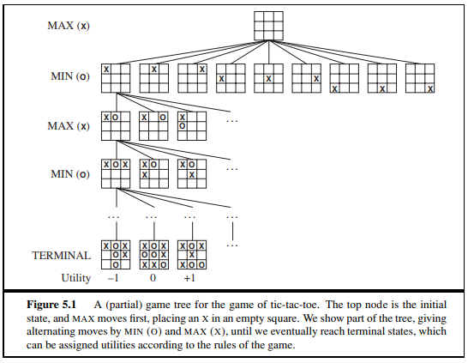
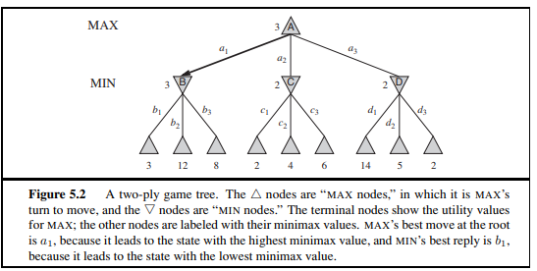
OPTIMAL DECISIONS IN GAMES:
In a normal search problem, the optimal solution would be a sequence of actions leading to a goal state—a terminal state that is a win.
In adversarial search, MIN has something to say about it.
MAX therefore must find a contingent strategy, which specifies MAX’s move in the initial state, then MAX’s moves in the states resulting from every possible response by MIN then MAX’s moves in the states resulting from every possible response by MIN to those moves, and so on.
Exactly analogous to the AND–OR search algorithm (Fig. 4.11) with MAX playing the role of OR and MIN equivalent to AND.
Roughly speaking, an optimal strategy leads to outcomes at least as good as any other strategy when one is playing an infallible opponent.
Even a simple game like tic-tac-toe is too complex for us to draw the entire game tree on one page, so we will switch to the trivial game in Fig. 5.2.
Possible moves for MAX at the root node are labeled a1, a2, and a3 and possible replies to a1 for MIN are b1, b2, b3, and so on.
This particular game ends after one move each by MAX and MIN and utilities of the terminal states in this game range from 2 to 14.

Slide 6

Given a game tree, the optimal strategy can be determined from the minimax value of each node, which we write as MINIMAX(n).
Minimax value of a terminal state is just its utility.
MAX prefers to move to a state of maximum value, whereas MIN prefers a state of minimum value.
The terminal nodes on the bottom level get their utility values from the game’s UTILITY function.
The first MIN node, labeled B, has three successor states with values 3, 12, and 8, so its minimax value is 3.
Similarly, the other two MIN nodes have minimax value 2.
The root node is a MAX node; its successor states have minimax values 3, 2, and 2; so it has a minimax value of 3. We can also identif
The minimax algorithm:
The minimax algorithm (Fig 5.3) computes the minimax decision from the current state.
It uses a simple recursive computation of the minimax values of each successor state, directly implementing the defining equations.
The recursion proceeds all the way down to the leaves of the tree, and then the minimax values are backed up through the tree as the recursion unwinds.
Ex: in Fig 5.2, the algorithm first recurses down to the three bottom left nodes and uses the UTILITY function on them to discover that their values are 3, 12, and 8, respectively
Then it takes the minimum of these values, 3, and returns it as the backed up value of node B.
A similar process gives the backed-up values of 2 for C and 2 for D and take the maximum of 3, 2, and 2 to get the backed-up value of 3 for the root node.
The minimax algorithm performs a complete depth-first exploration of the game tree.
If the maximum depth of the tree is m and there are b legal moves at each point, then the time complexity of the minimax algorithm is O(b ^{m}).

Slide 7
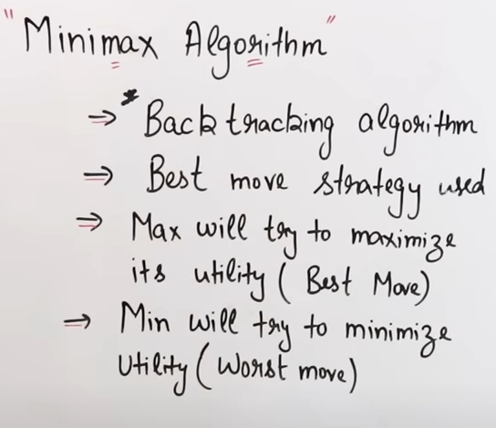
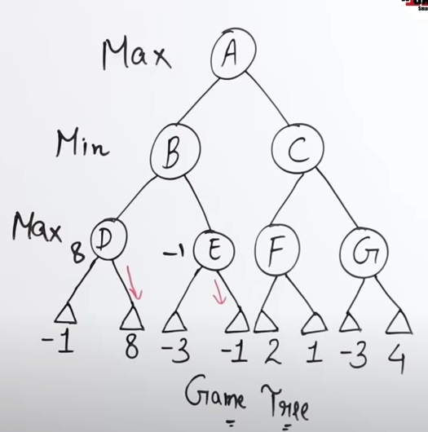
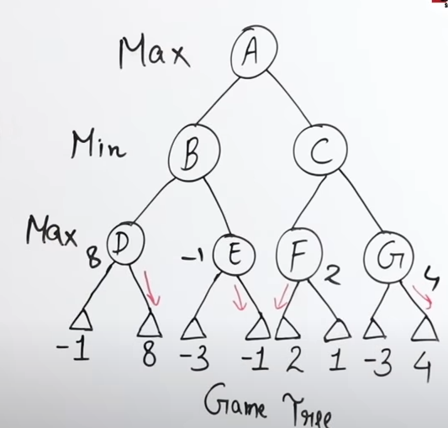
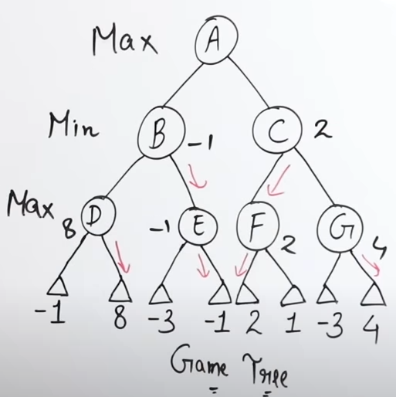
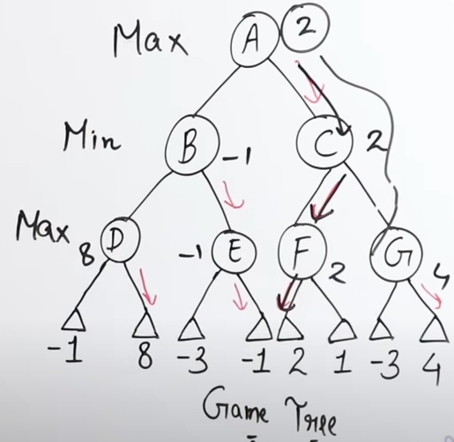
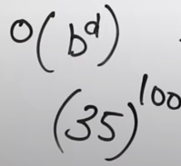
Time Comlexity
Ex; For Chess Game

Slide 8
Alpha-Beta pruning
The problem with minimax search is that the number of game states it has to examine is exponential in the depth of the tree.
Unfortunately, we can’t eliminate the exponent, but it turns out we can effectively cut it in half.
The trick is that it is possible to compute the correct minimax decision without looking at every node in the game tree.
Borrow the idea of pruning to eliminate large parts of the tree from consideration.
The particular technique we examine is called alpha–beta pruning.
When applied to a standard minimax tree, it returns the same move as minimax would, but prunes away branches that cannot possibly influence the final decision.
Consider again the two-ply game tree from Figure 5.2.
Let’s go through the calculation of the optimal decision once more, this time paying careful attention to what we know at each point in the process.

Slide 9
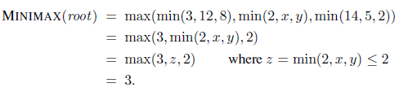
The steps are explained in Figure 5.5.
Identify the minimax decision without ever evaluating two of the leaf nodes and is the simplification of the formula for MINIMAX.
Let the two unevaluated successors of node C in Figure 5.5 have values x and y.
Then the value of the root node is given by
Value of the root and minimax decision are independent of the values of the pruned leaves x and y.
Alpha–beta pruning can be applied to trees of any depth, and it is often possible to prune entire subtrees rather than just leaves.

Slide 10
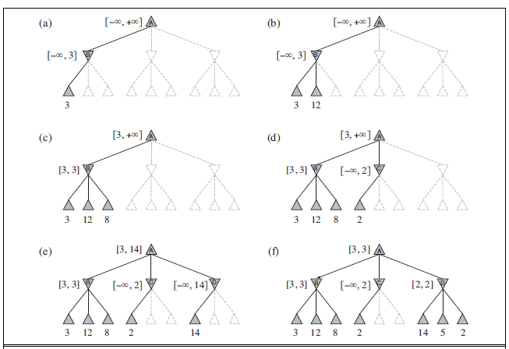

Slide 11
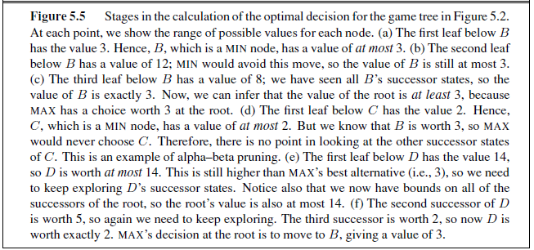

Slide 12
The general principle is this: consider a node n somewhere in the tree (see Figure 5.6), such that Player has a choice of moving to that node.
If Player has a better choice m either at the parent node of n or at any choice point further up, then n will never be reached in actual play.
So once we have found out enough about n (by examining some of its descendants) to reach this conclusion, we can prune it.
minimax search is depth-first, so at any one time we just have to consider the nodes along a single path in the tree.
Alpha–beta pruning gets its name from the following two parameters that describe bounds on the backed-up values that appear anywhere along the path:
α = the value of the best (i.e., highest-value) choice we have found so far at any choice point along the path for MAX.
β = the value of the best (i.e., lowest-value) choice we have found so far at any choice point along the path for MIN.

Slide 13
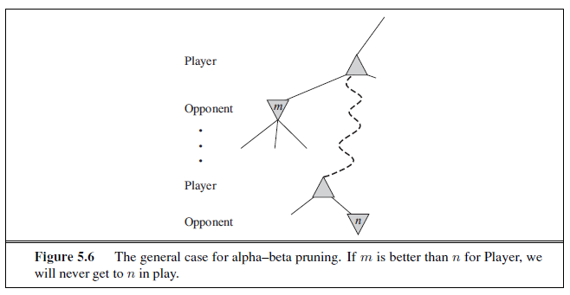
Alpha–beta search updates the values of α and β as it goes along and prunes the remaining branches at a node (i.e., terminates the recursive call) as soon as the value of the current node is known to be worse than the current α or β value for MAX or MIN, respectively.
The complete algorithm is given in Figure 5.7. We encourage you to trace its behavior when applied to the tree in Figure 5.5.

Slide 14
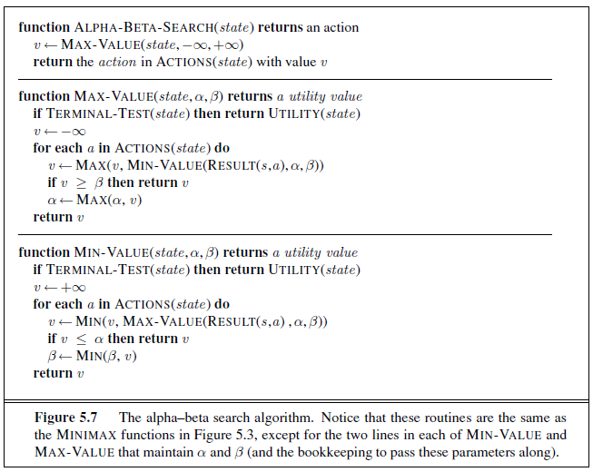

Slide 15
Move ordering
Effectiveness of alpha–beta pruning is highly dependent on the order in which the states are examined.
Ex: in Figure 5.5(e) and (f), we could not prune any successors of D at all because the worst successors (from the point of view of MIN) were generated first.
If the third successor of D had been gen1erated first, we would have been able to prune the other two.
This suggests that it might be worthwhile to try to examine first the successors that are likely to be best.
If this can be done, then it turns out that alpha–beta needs to examine only O(b^{m/2}) nodes to pick the best move, instead of O(b^{m}) for minimax.
This means that the effective branching factor becomes √b instead of b—for chess, about 6 instead of 35.
Put another way, alpha–beta can solve a tree roughly twice as deep as minimax in the same amount of time.

Slide 16
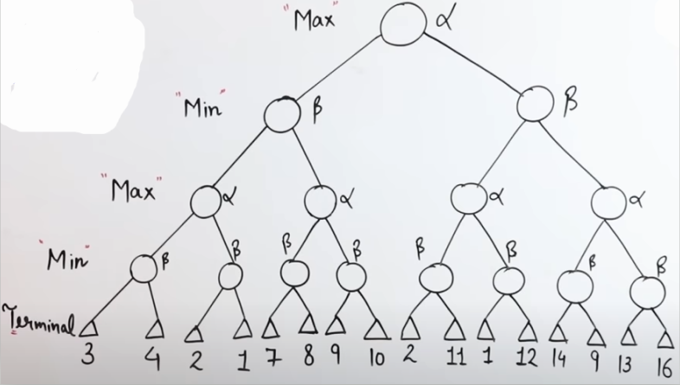
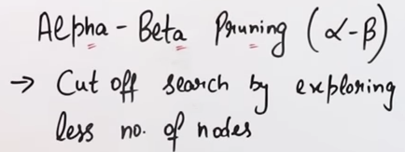
O(b^{d}) O(b^{d/2})

Slide 17
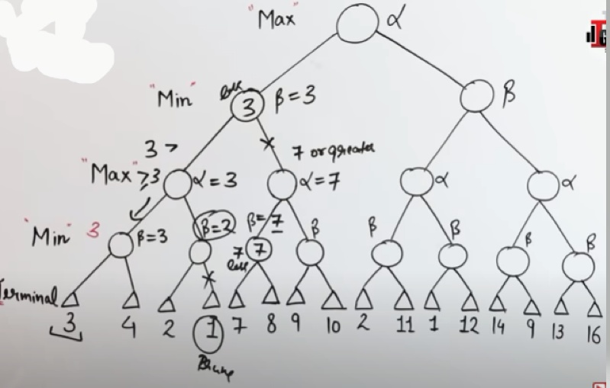
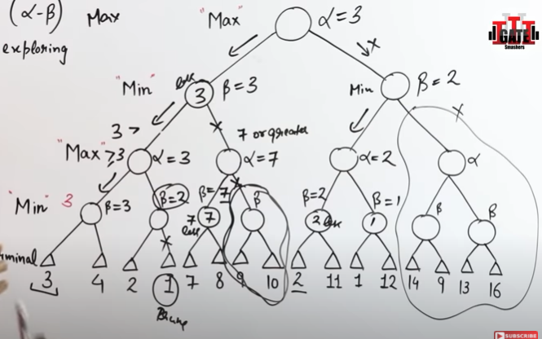

Slide 18
CONSTRAINT SATISFACTION PROBLEM
Use a factored representation for each state: a set of variables, each of which has a value.
A problem is solved when each variable has a value that satisfies all the constraints on the variable.
A problem described this way is called a constraint satisfaction problem, or CSP.
CSP search algorithms take advantage of the structure of states and use general-purpose rather than problem-specific heuristics to enable the solution of complex problems.
The main idea is to eliminate large portions of the search space all at once by identifying variable/value combinations that violate the constraints.
DEFINING CONSTRAINT SATISFACTION PROBLEMS
A constraint satisfaction problem consists of three components, X, nD, ad C:
X is a set of variables, {X₁,...,X_{n}}.
D is a set of domains, {D₁,...,D_{n}}, one for each variable. C is a set of constraints that specify allowable combinations of values.
Each domain D_{i} consists of a set of allowable values, {v₁,...,v_{k}} for variable X_{i}.
Each constraint C_{i} consists of a pair {scope, rel}, where scope is a tuple of variables that participate in the constraint and rel is a relation that defines the values that those variables can take on.
A relation can be represented as an explicit list of all tuples of values that satisfy the constraint, or as an abstract relation that supports two operations: testing if a tuple is a member of the relation and enumerating the members of the relation.

Slide 19
Ex: if X1 and X2 both have the domain {A,B}, then the constraint saying the two variables must have different values can be written as (X1,X2), [(A,B), (B,A)] or as ((X1,X2),X1 ≠ X2).
To solve a CSP, we need to define a state space and the notion of a solution. Each state in a CSP is defined by an assignment of values to some or all of the variables, {Xi = vi,Xj = vj , . . .}.
An assignment that does not violate any constraints is called a consistent or legal assignment.
A complete assignment is one in which every variable is assigned, and a solution to a CSP is a consistent, complete assignment.
A partial assignment is one that assigns values to only some of the variables.
Example problem: Map coloring
Suppose that, having tired of Romania, we are looking at a map of Australia showing each of its states and territories (Figure 6.1(a)).
We are given the task of coloring each region either red, green, or blue in such a way that no neighboring regions have the same color.
To formulate this as a CSP, we define the variables to be the regions X = {WA,NT,Q,NSW, V,SA, T} .
The domain of each variable is the set Di = {red , green, blue}.
The constraints require neighboring regions to have distinct colors. Since there are nine places where regions border, there are nine constraints:
C = {SA = WA,SA = NT,SA = Q,SA = NSW,SA = V,
WA = NT,NT = Q,Q = NSW,NSW = V } .
Here we are using abbreviations; SA = WA is a shortcut for (SA,WA),SA = WA, where SA = WA can be fully enumerated in turn as {(red , green), (red , blue), (green, red ), (green, blue), (blue, red ), (blue, green)} .

Slide 20
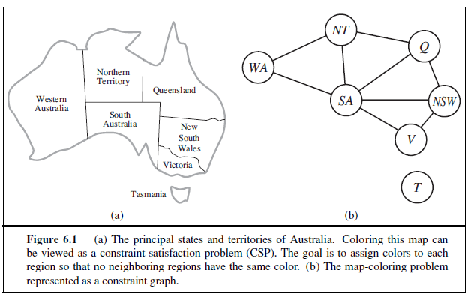
There are many possible solutions to this problem, such as {WA=red ,NT =green,Q=red ,NSW =green, V =red ,SA=blue, T =red }
It can be helpful to visualize a CSP as a constraint graph, as shown in Figure 6.1(b).
CONSTRAINT PROPAGATION: INFERENCE IN CSPS
In CSPs there is a choice: an algorithm can search or do a specific type of inference called constraint propagation: using the constraints to reduce the number of legal values for a variable, which in turn can reduce the legal values for another variable, and so on.
Constraint propagation may be intertwined with search, or it may be done as a pre-processing step, before search starts.
Sometimes this pre-processing can solve the whole problem, so no search is required at all.

Slide 21
BACKTRACKING SEARCH FOR CSPS
Sudoku problems are designed to be solved by inference over constraints.
Look at backtracking search algorithms that work on partial assignments; look at local search algorithms over complete assignments.
A state would be a partial assignment, and an action would be adding var = value to the assignment.
Branching factor at the top level is nd because any of d values can be assigned to any of n variables.
At the next level, the branching factor is (n − 1)d, and so on for n levels. We generate a tree with n! . dn leaves, even though there are only dn possible complete assignments!
The key idea is local consistency. If we treat each variable as a node in a graph (see Figure 6.1(b)) and each binary constraint as an arc, then the process of enforcing local consistency in each part of the graph causes inconsistent values to be eliminated throughout the graph.
Node consistency
A single variable is node-consistent if all the values in the variable’s domain satisfy the variable’s unary constraints.
Ex: in the variant of the Australia map-coloring problem (Figure 6.1) where South Australians dislike green, the variable SA starts with domain {red , green, blue}, and we can make it node consistent by eliminating green, leaving SA with the reduced domain {red , blue}.
We say that a network is node-consistent if every variable in the network is node-consistent.

Slide 22
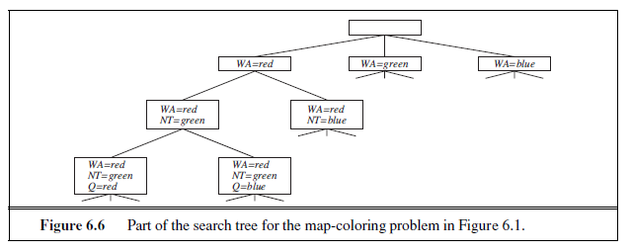
BACKTRACKING-SEARCH keeps only a single representation of a state and alters that representation rather than creating new ones.
Improved the poor performance of uninformed search algorithms by supplying them with domain-specific heuristic functions derived from our knowledge of the problem.
It turns out that we can solve CSPs efficiently without such domain-specific knowledge.
Instead, add some sophistication to the unspecified functions in Figure 6.5,
using them to address the following questions:
1. Which variable should be assigned next (SELECT-UNASSIGNED-VARIABLE), and in what order should its values be tried (ORDER-DOMAIN-VALUES)?
2. What inferences should be performed at each step in the search (INFERENCE)?
3. When the search arrives at an assignment that violates a constraint, can the search avoid repeating this failure?

Slide 23
The backtracking algorithm contains the line var ←SELECT-UNASSIGNED-VARIABLE(csp) .
The simplest strategy for SELECT-UNASSIGNED-VARIABLE is to choose the next unassigned variable in order, {X1,X2, . . .}.
This static variable ordering seldom results in the most efficient search.
Ex: after the assignments for WA=red and NT =green in Figure 6.6, there is only one possible value for SA, so it makes sense to assign SA=blue next rather than assigning Q.

